Slide 1

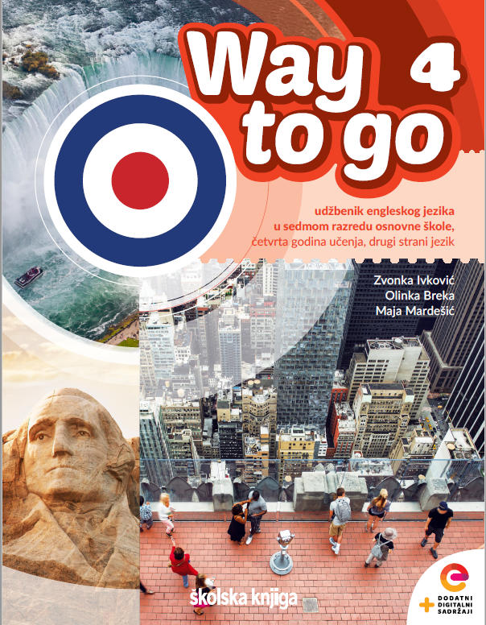
Unit 1: Culture spot 1
The Big Apple

Slide 2
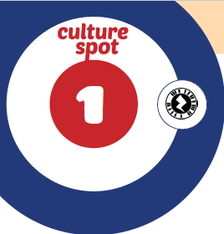
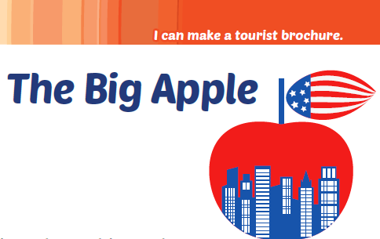
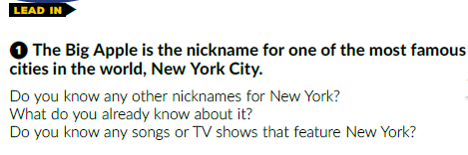

Slide 3
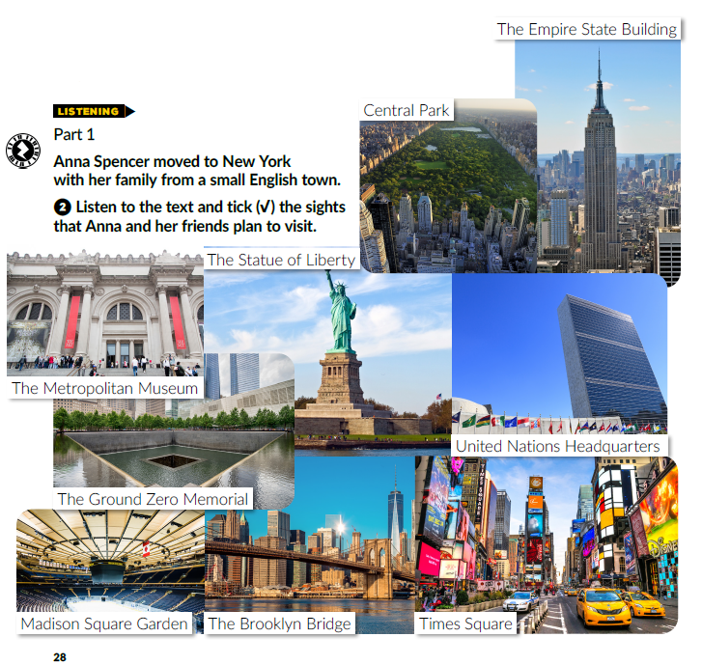

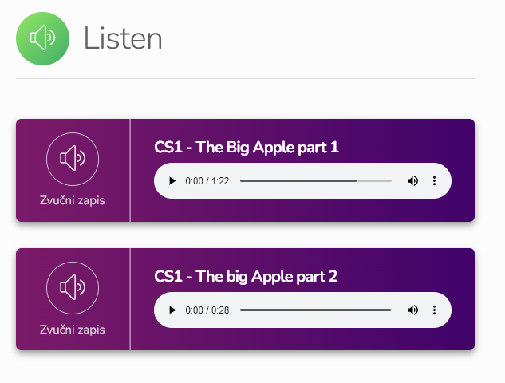
https://www.e-sfera.hr/dodatni-digitalni-sadrzaji/d164178e-abc0-4b71-bbc6-5e79dd656947/

Slide 4
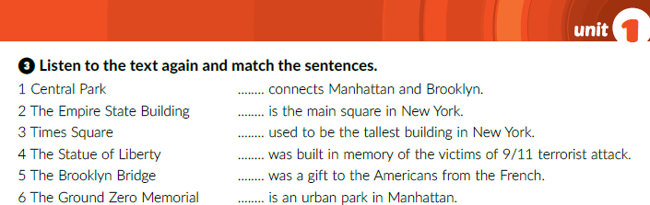
5
3
2
6
4
1
https://www.e-sfera.hr/dodatni-digitalni-sadrzaji/d164178e-abc0-4b71-bbc6-5e79dd656947/

Slide 5
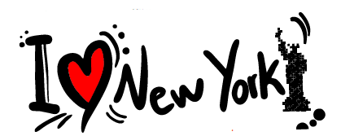


Slide 6
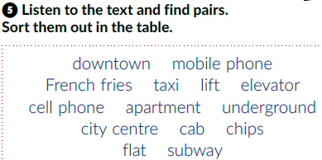
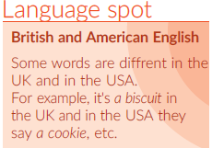
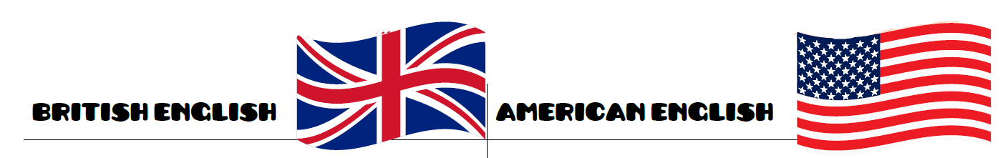
city centre
downtown
mobile phone
cell phone
chips
French fries
taxi
cab
lift
elevator
flat
apartment
underground
subway

Slide 7
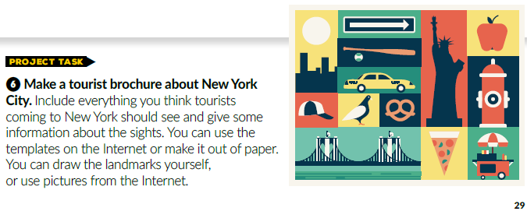

Slide 8

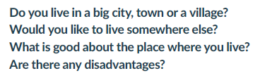
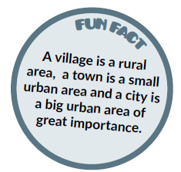

Slide 9

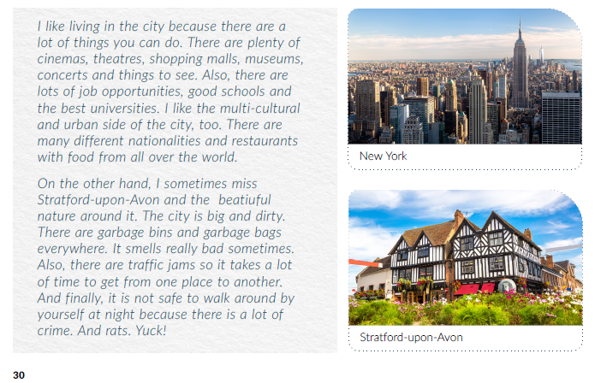
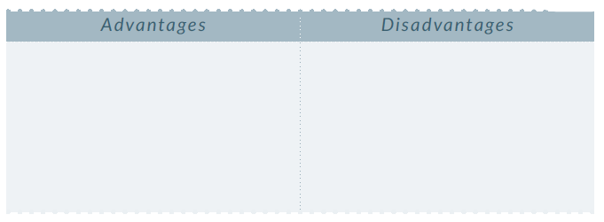
a lot of things you can do
the city is dirty, garbage bins and bags are everywhere; bad smell
plenty of cinemas, theatres, shopping malls, museums, and things to see
traffic jams
a lot of crime; not safe at night
lots of job opportunities, good schools and universities
lots of rats

Slide 10
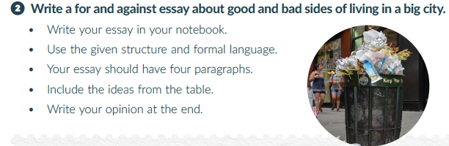
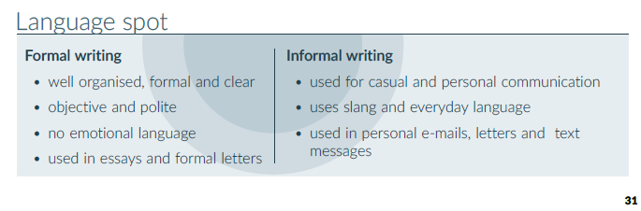

Slide 11
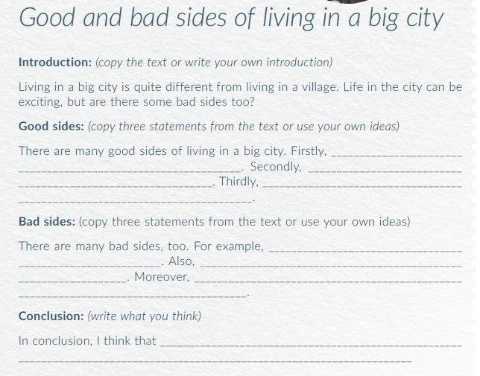
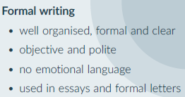
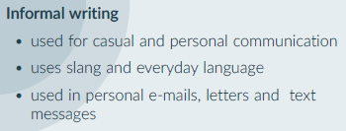

Slide 12
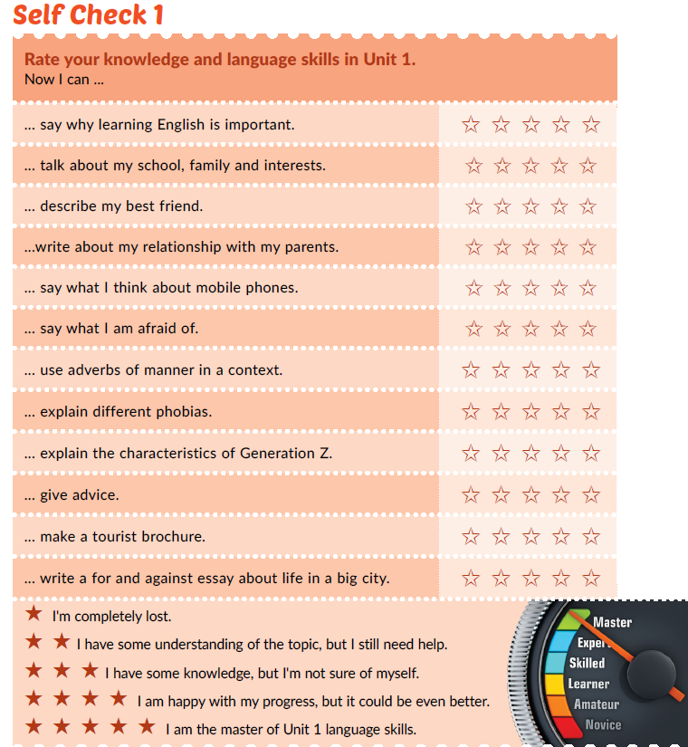

Slide 13
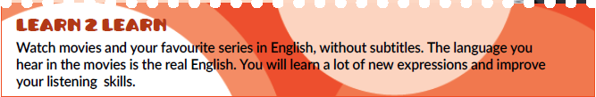

Slide 14

PLAY AND LEARN
https://www.e-sfera.hr/dodatni-digitalni-sadrzaji/d164178e-abc0-4b71-bbc6-5e79dd656947/

